Slide 1

Characterization of Diffusion from Mesoporous Silica Nanoparticles for Potential Drug-Delivery Applications
Kate Li
Chemical Engineering & Biochemistry

Slide 2
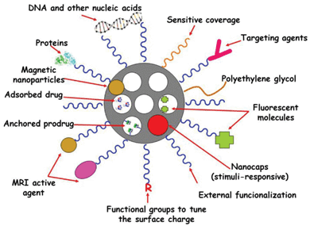
Mesoporous Silica Nanoparticles
Figure 1: Diagram of different ways to functionalize a mesoporous silica nanoparticle – external and pore surface functionalization (Colila et. al 2013).

Slide 3
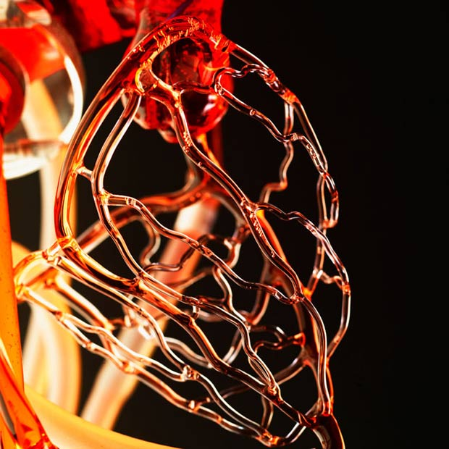
Why MSNPs?
Tunable drug delivery
Antibodies for site specificity
Within threshold size for cellular uptake (D ~100 nm)
Controlled and sustained release
Applications: chemo toxic drugs, nonpolar with low bioactivity in the body due to poor solubility
Silica is bioinert
Glass cardiovascular system sculpture by Gary Farlow

Slide 4
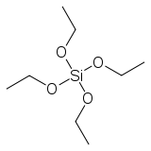
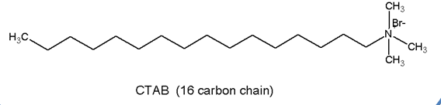
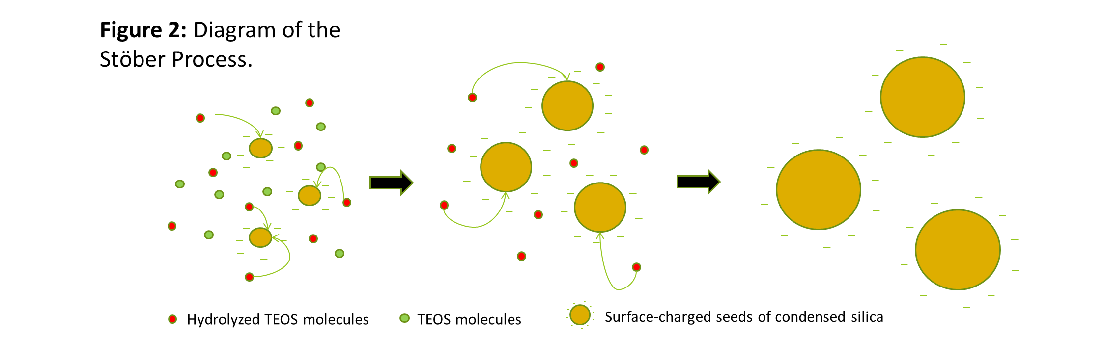
Modified Stӧber Process
Reagents:
Cetyltetra-ammoniumbutylate (CTAB)
Tetraethyl orthosilicate (TEOS)
NaOH
EtOH
Water

Slide 5
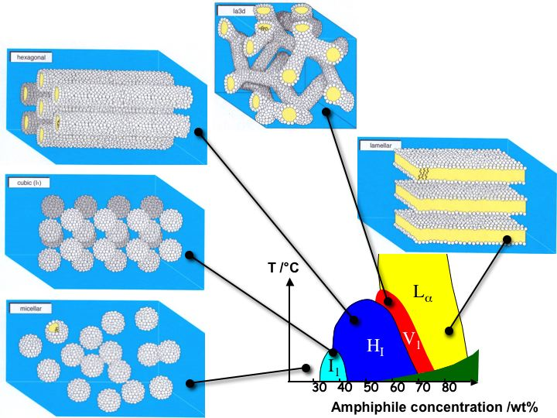
Forming a Liquid Crystal

Slide 6
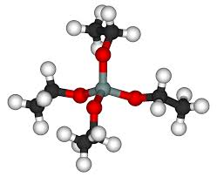
Experimental Procedure
Materials:
- TEOS (tetra ethyl orthosilicate)
- EtOH (ethanol)
- CTAB (cetyl trimethylammonium bromide)
- NaOH (sodium hydroxide)
- dI H₂O(deionized water)
Characterization:
- N2 absorption
- SEM, TEM, SAXRD
Procedure:
Add .375 g of CTAB, .4375 mL 2.0 M NaOH and 30 mL dI H₂O to roundbottom flask with magnetic stir bar and heat to 80⁰C for 30 minutes.
To clear solution, add 2.48 mL TEOS via rapid injection.
White precipitate will be observed after 1-2 minutes of stirring.
Maintain reaction temperature at 80⁰C for 2 hrs.
Isolate product via ethanol wash and centrifugation/sonication cycles of 10 minutes each, four times. Dilute and suspend in ethanol.

Slide 7
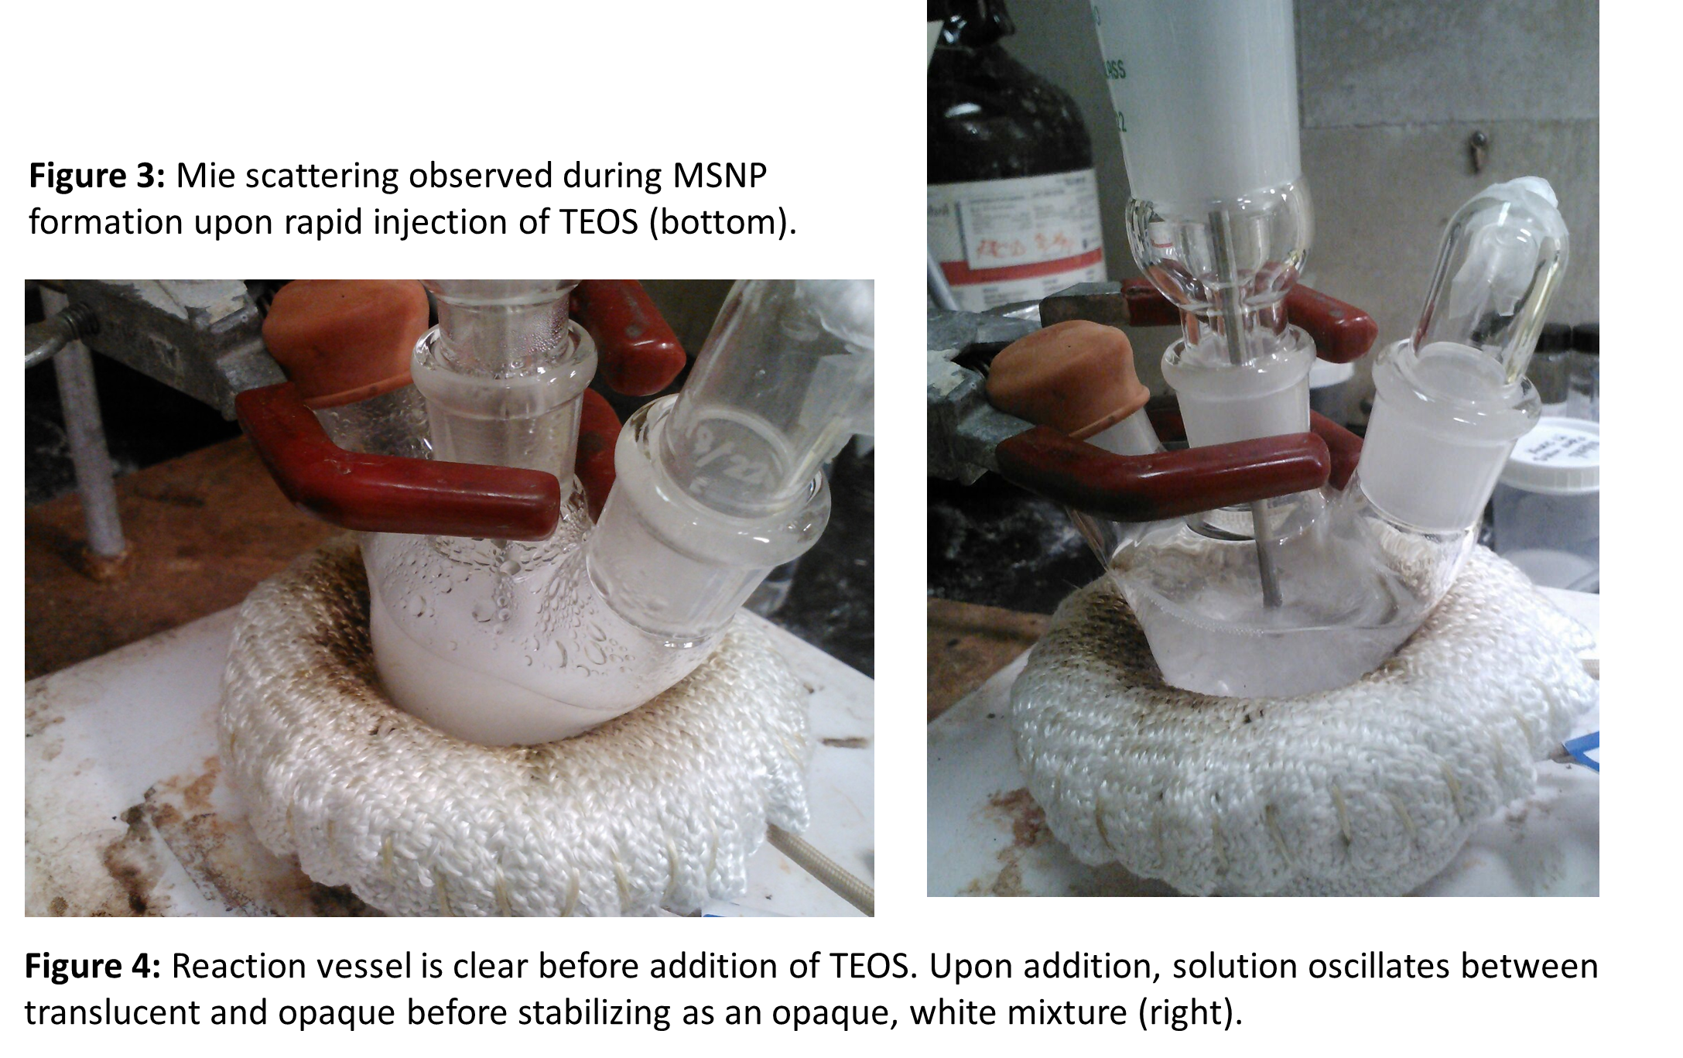
Experimental Observations

Slide 8
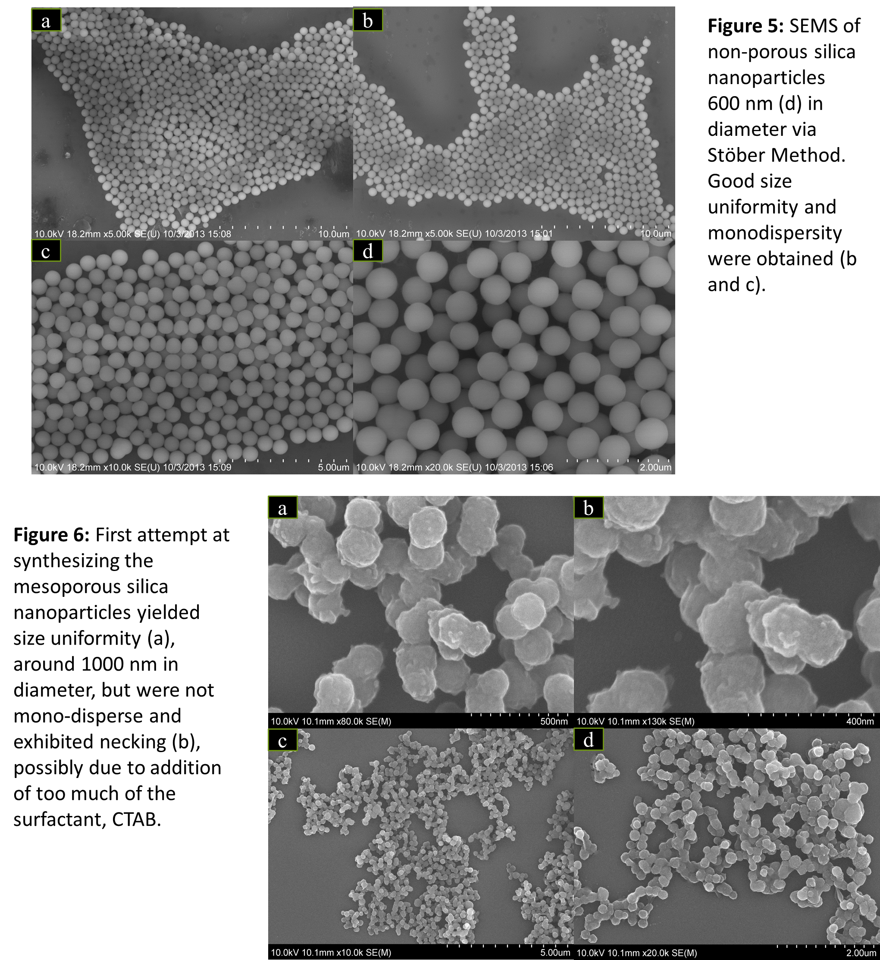
Results

Slide 9
Results

Slide 10
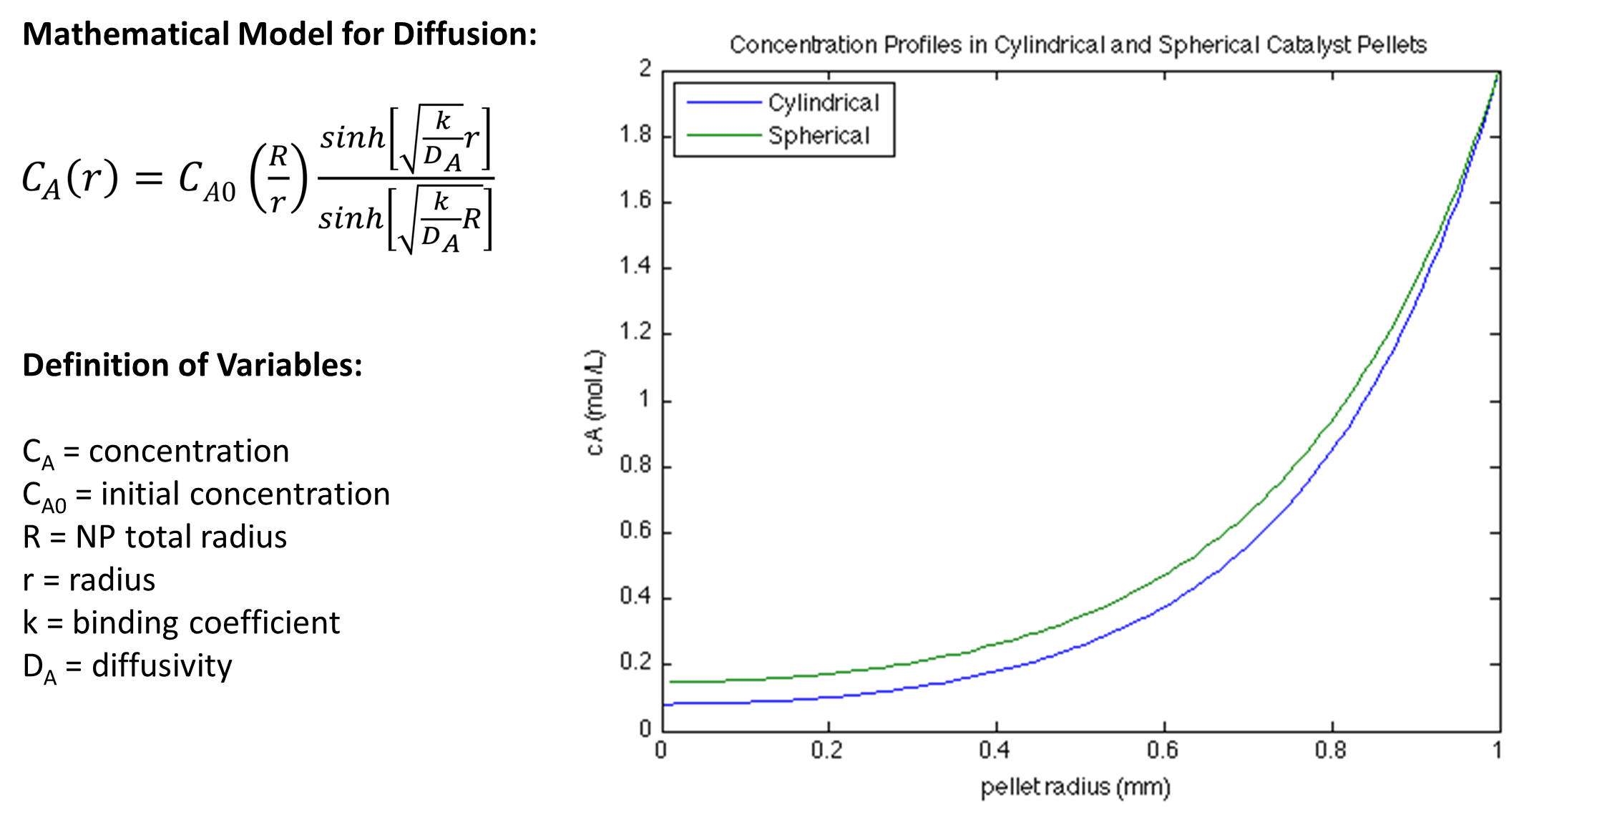
Theoretical Modeling

Slide 11
Further research
Further research on the parameters of the Modified Stӧber Process
Attempting functionalization of surface and pores
Generate diffusion data

Slide 12

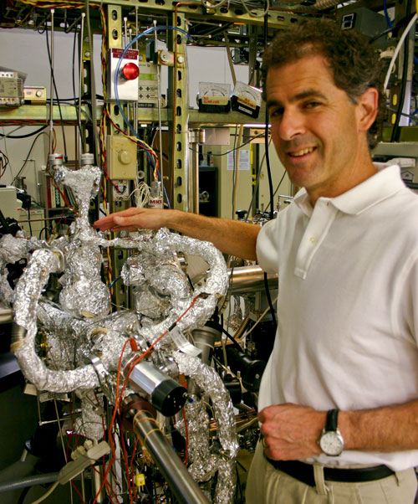

Questions?
Thank you
NASA Space Grant
UA Honors College – Alumni Travel Grants
Dr. Anthony Muscat
NASA Space Grant Consortium

